Slide 1
--Q1: In 2007, what were the names of our top 6 paying clients, how many monthly payments did they make, and how much money did they pay in total?--
We can observe that Our top 6 paying costumer are Clara Shaw, Eleanor Hunt, Karl Seal, Marion Snyder, Rhonda Kennedy, Tommy Collazo.
The highest amount of payment from our top 6 paying client is Eleanor Hunt by a total payment amount 211.55 USD
Elanor’s monthly payment count has the highest count of pay times per month by total 45 payment times
To have the loyalty of the top 6 clients to grow the business has to offer the clients some VIP services or special discounts in order to make the client loyalty grow.
Values
Notes:
/*Q1: In 2007, what were the names of our top 6 paying clients, how many monthly payments did they make, and how much money did they pay in total?
Solution:*/
SELECT
DATE_TRUNC('month', pa.payment_date) "Payment date",
cu.first_name || ' ' || cu.last_name "Coustmer Full name",
COUNT(pa.amount) "Pay Counter per month",
SUM(pa.amount) "Amount of payment"
FROM
payment AS pa
JOIN customer AS cu ON cu.customer_id = pa.customer_id
WHERE
cu.first_name || ' ' || cu.last_name IN (
SELECT
sub1.full_name
FROM
(
SELECT
SUM(pa.amount) Total,
cu.first_name || ' ' || cu.last_name full_name
FROM
payment AS pa
JOIN customer AS cu ON cu.customer_id = pa.customer_id
GROUP BY
2
ORDER BY
1 DESC
LIMIT
6
) sub1
)
AND (
pa.payment_date BETWEEN '2007-01-01'
AND '2008-01-01'
)
GROUP BY
2,
1
ORDER BY
2,
3 DESC;

Slide 2
--Q2: Create a query to determine the total rental orders for each film genre.--
Sports films category has a high range counts of rental orders by 1179 order
Animation films category has a high range counts of rental orders by 1166 order
Hence, the highest rental orders count of two films categories is Sports and animation films, which is the most successful films so far.
Music films category has a low range counts of rental orders by 830 order; hence it the lowest rental orders
Notes:
/*Q2: Create a query to determine the total rental orders for each film genre.
Solution:*/
WITH Sub1 AS (
SELECT
i.film_id
FROM
inventory i
JOIN rental ren ON ren.inventory_id = i.inventory_id
),
Sub2 AS (
SELECT
cat.name category_name,
fi.title film_title,
fi.film_id
FROM
film fi
JOIN film_category fcat ON fcat.film_id = fi.film_id
JOIN category cat ON cat.category_id = fcat.category_id
)
SELECT
count(*) "Rental Count",
Sub2.category_name AS "Film Category"
FROM
Sub2
JOIN Sub1 ON Sub2.film_id = Sub1.film_id
GROUP BY
2
ORDER BY
1 DESC;

Slide 3
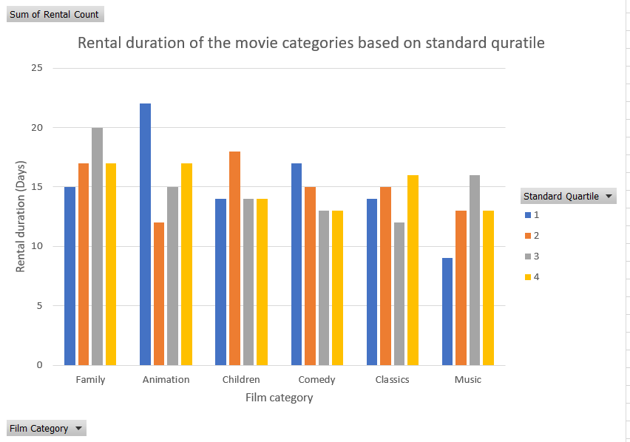
--Q3: provide a table with the family-friendly film category, each of the quartiles, and the corresponding count of movies within each combination of film category for each corresponding rental duration category.--
Family films has the highest rental length in all categories.
Animation films category comes after has a high rental range in all category
Classics and comedy and children have a middle rental range in all quarters.
Music movies has the lowest rental range in all quarters.
Notes:
/* Q3:
Finally, provide a table with the family-friendly film category, each of the quartiles, and the corresponding count of movies within each combination of film category for each corresponding rental duration category. The resulting table should have three columns:
Category
Rental length category
Count
Solution:*/
SELECT
sub.name AS "Film Category",
sub.standard_quartile AS "Standard Quartile",
COUNT(*) AS "Rental Count"
FROM
(
SELECT
cat.name,
f.rental_duration,
NTILE(4) OVER(
ORDER BY
f.rental_duration
) AS standard_quartile
FROM
category AS cat
JOIN film_category AS fcat ON cat.category_id = fcat.category_id
AND cat.name IN (
'Animation', 'Children', 'Classics',
'Comedy', 'Family', 'Music'
)
JOIN film AS f ON f.film_id = fcat.film_id
) sub
GROUP BY
1,
2
ORDER BY
1,
2;

Slide 4
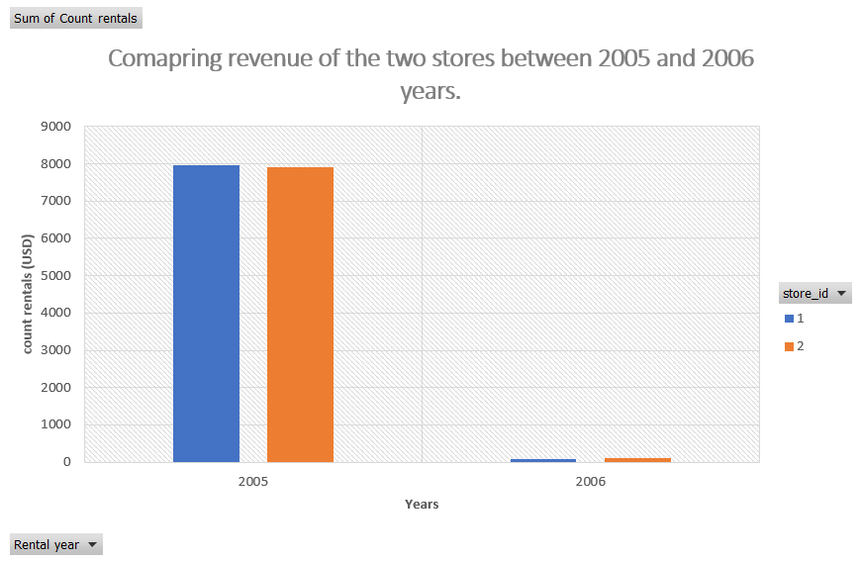
--Q4: We want to find out how the two stores compare in their count of rental orders during every month for all the years we have data for.--
The grand total for store ID 1 and 2 in 2005 was excellent and high and equally balanced between the two stores.
The raising in 2006 is lower than the previous year.
In order to get money, the store must make adjustments that add more value to the store, hence Improvement is needed.
Notes:
/*Q4:
We want to find out how the two stores compare in their count of rental orders during every month for all the years we have data for.ÊWrite a query that returns the store ID for the store, the year and month and the number of rental orders each store has fulfilled for that month. Your table should include a column for each of the following: year, month, store ID and count of rental orders fulfilled during that month.
Solution:*/
SELECT
s.store_id,
EXTRACT(
ISOYEAR
FROM
r.rental_date
) AS "Rental year",
EXTRACT(
MONTH
FROM
r.rental_date
) AS "Rental month",
COUNT(r.rental_id) AS "Count rentals"
FROM
rental r
JOIN staff USING (staff_id)
JOIN store s USING (store_id)
GROUP BY
1,
2,
3
ORDER BY
1,
2,
3;

